Slide 1
Force Function
Studio 5000
© 2021 John Sefcovic

Slide 2
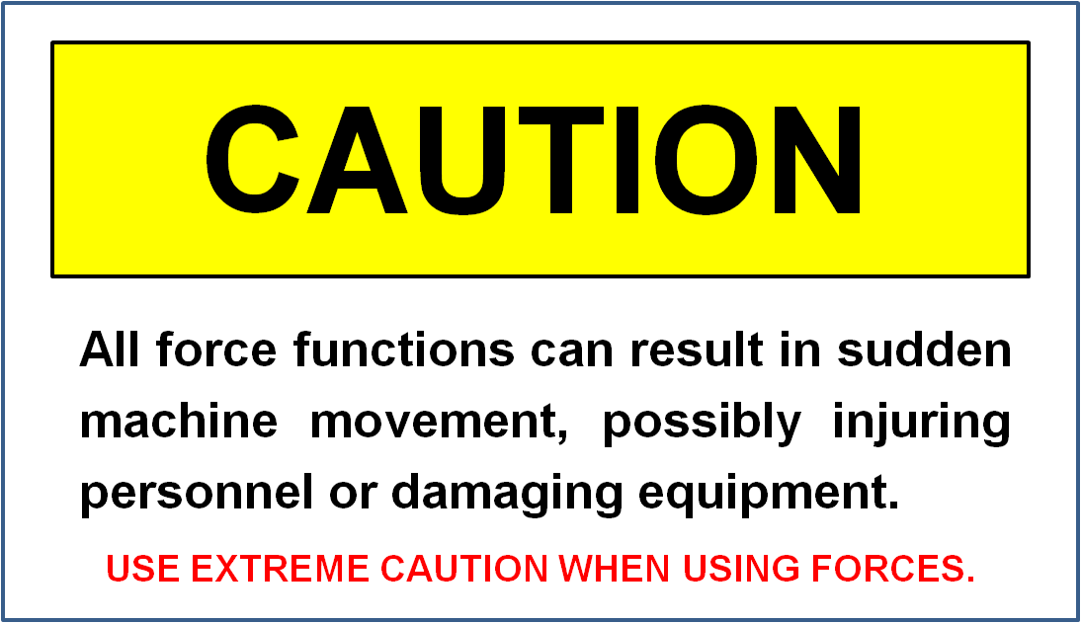
Forcing – Studio 5000

Slide 3
Forcing – Studio 5000
Only Inputs and Outputs can be FORCED.
Forces can be added in the Tag Table or in the Ladder Program.
Forces must be ENABLED.
Once Forces are Enabled, all forces then added are automatically Enabled.
All or Individual Forces can be Removed.
All Forces can be Disabled, but remain in program

Slide 4

Forcing – Studio 5000
Forcing in Monitor Tags Editor
In the Tag Table (Controller or Parameters and Local) type in the Force Mask field for the Input or Output Tag a 1 or a 0.
1 is Force On
0 is Force Off
Monitor Tags must be selected.

Slide 5
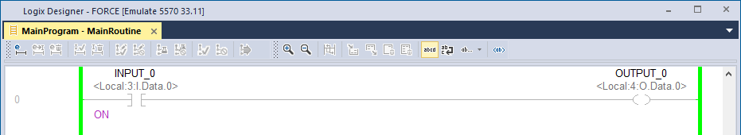
Forcing – Studio 5000
Forcing in Program Logic
In the Ladder Program an ON or OFF is shown by the instruction associated with the Tag for the Force Type.

Slide 6
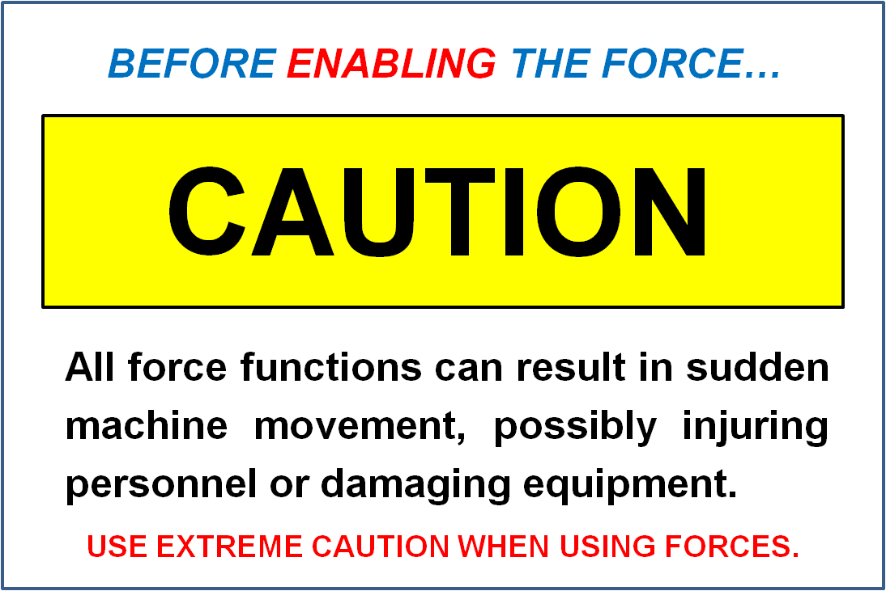
Forcing – Studio 5000
Enable Forces

Slide 7
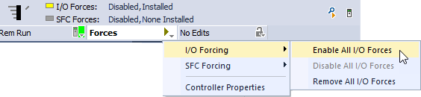
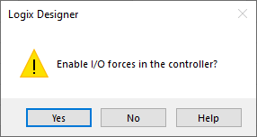
Forcing – Studio 5000
Enable Forces
To Enable Forces select on the Toolbar Forces, the Arrow, I/O Forcing, and then Enable All I/O Forces.
At the prompt select Yes to Enable.
All Forces will be active.

Slide 8

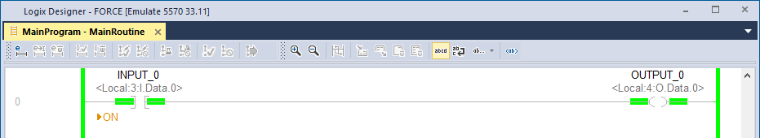
Forcing – Studio 5000
Enabled Forces
In the Tag Table and Ladder Program an Arrowhead is added to indicate the Force is Enabled

Slide 9
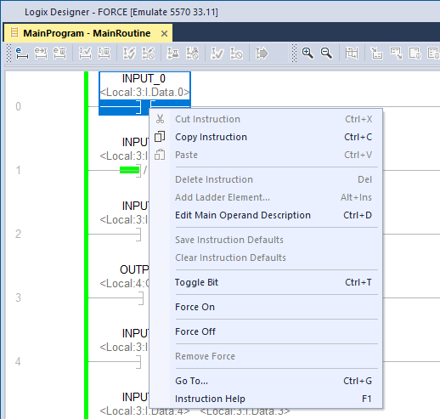
Forcing – Studio 5000
Forcing in Program Logic
Forces can be added in the Ladder Program by right click on the instruction and selecting a Force Type from the context menu.
If Forces are ENABLED, any added Forces will be active immediately.
If Forces are not ENABLED, then Enable from the Toolbar.

Slide 10

Forcing – Studio 5000
Disabling All Forces

Slide 11
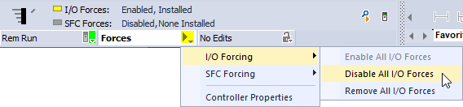
Forcing – Studio 5000
Disabling All Forces
To Enable Forces select on the Toolbar Forces, the Arrow, I/O Forcing, and then Disable All I/O Forces.

Slide 12

Forcing – Studio 5000
Disabling All Forces
The Forces are still present, but inactive.
Disabled Forced Inputs revert to the current status (Voltage or No Voltage) at the Input Module’s termination.
Disabled Forced Outputs revert to the current solved status of the rung for Voltage or No Voltage at the Output Module’s termination.

Slide 13
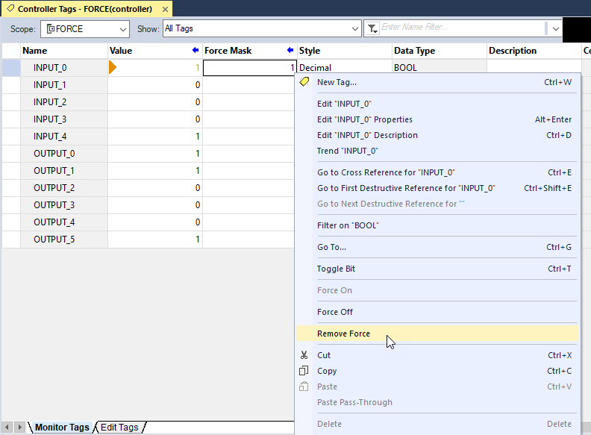
Forcing – Studio 5000
Remove a Force from Tag Table
Right click on the Tag’s line and select Remove Force from the context menu.

Slide 14
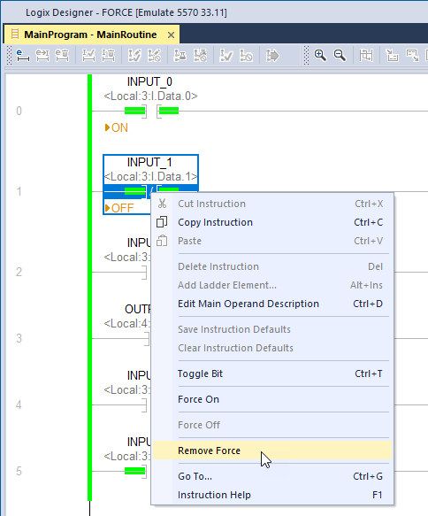
Forcing – Studio 5000
Remove a Force from Ladder Program
Right click on the instruction and select Remove Force from the context menu.

Slide 15
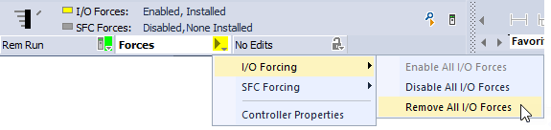
Forcing – Studio 5000
Removing All Forces
To Enable Forces select on the Toolbar Forces, the Arrow, I/O Forcing, and then Remove All I/O Forces.
All the Forces are deleted.

Slide 16
Forcing – Studio 5000
When Forcing be aware of the consequences of the force.
Check when Forcing Inputs to turn on an Output, is the output’s Tag used on Input instructions.
Check when a Forcing Input is the same Tag used on additional Input instructions.
Be aware when Forcing Outputs the physical output is changed, turned On or Off, the data Tag value does not change.

Slide 17
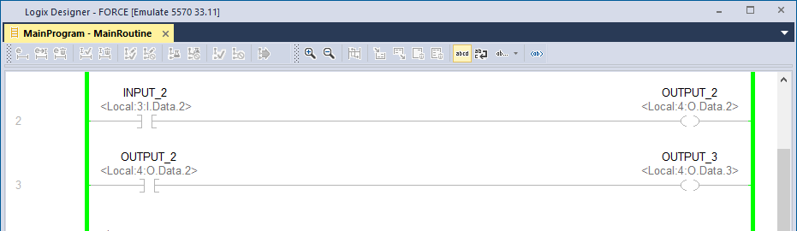
Forcing – Studio 5000
Forces Inputs
The Tag OUTPUT_2 is used on the next rung as the Tag for an Input instruction.

Slide 18
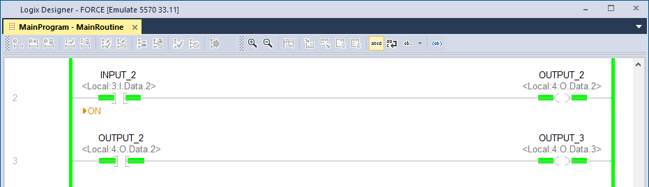
Forcing – Studio 5000
Forces Inputs
When INPUT_2 is Forced On the rung is True and sets, turns On, OUTPUT_2.
The Input instruction with the Tag OUTPUT_2 is True causing an additional Output, OUTPUT_3, to turn On.

Slide 19
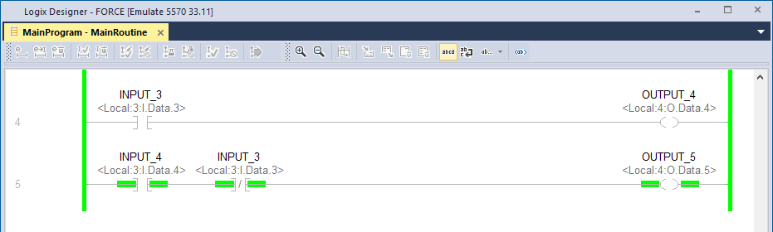
Forcing – Studio 5000
Forces Inputs
The Tag is used on multiple Input instructions.

Slide 20
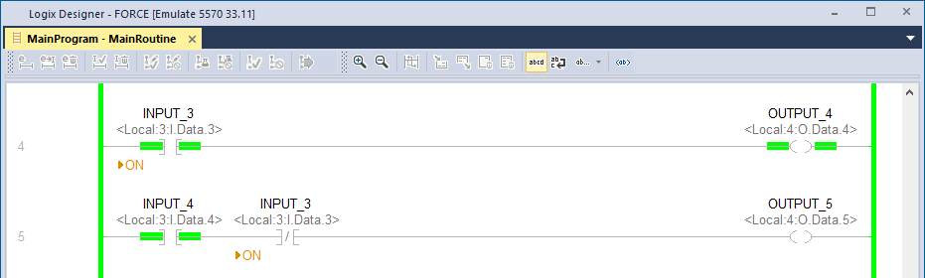
Forcing – Studio 5000
Forces Inputs
The Force will be applied to all Input instruction with the same Tag.
The instruction type will then be interpreted based on the force type.

Slide 21
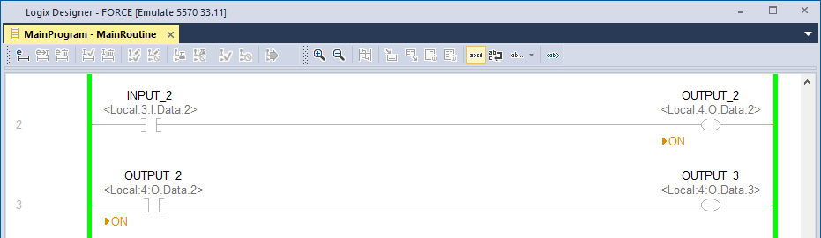
Forcing – Studio 5000
Forces Outputs
When an Output is Forced, the physical output is changed.

Slide 22
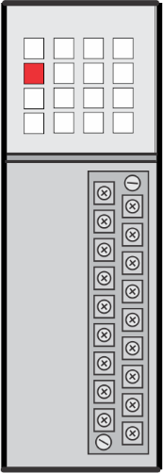

Forcing – Studio 5000
Forces Outputs
When an Output is Forced, the physical output is changed.
Local:4:O.Data.2
The device wired to the associated address terminal is turned On by the Force On.

Slide 23
Forcing – Studio 5000
Forces Outputs
Local:4:O.Data.2
Because the Output Tag data is not changed by the Force, there is no change to other instruction with the same Tag data.

